Slide 1



Database Design & Management:
Drug Stock of a Government Hospital
Prepared by Group 12:
Drishti Kishore (1805341)
Shraddha Saumya (1805342)
Abir Ghosh (1805361)

Slide 2

CONTENTS
Facts & Requirements
Need
Analysis
ER Diagram
Drug Stock

Slide 3



Need
“
It's a Necessity
“
Details of drugs supplied by the hospital.
Record of received drugs.
Record of consumed drugs.
Track of drugs currently in stock.
Track of expired drugs that need to be destroyed.
Record of consumed drug & its quantity with corresponding OPD visit.
Track of drugs closing in on expiry or going out of stock and need to be reordered.

Slide 4

Government Hospitals in India still use the Flat File Method
Limitations
Data Redundancy
Data Inconsistency
Data Insecurity
Concurrent Access
Memory Utilization
Flexibility
Need

Slide 5

Facts and Requirements
Facts
No brand name, only drug name.
Zero cost drugs, Re. 1 charged for prescription.
Drugs received: At the beginning of the month/ in the middle of the month.
Expired drugs destroyed: At the end of the month.
Newer drug stocks: not opened until older stock is consumed or expires.
Databases maintained for management of drug stock:
1.Stock Register
2.Consumption Register

Slide 6

Steps to Receive* Drugs in a Government Hospital
STEP 01
OPD No. serially assigned to patients.
STEP 02
Re. 1 prescription rceived.
STEP 03
Drugs prescribed received on the corresponding OPD No.
Facts
*from patient's perspective

Slide 7


Requirements
2 Databases maintained
Stock Register
Serial No. | Name of Medicine | Received Quantity | Date | Consumption | Balance | Remark
1 | Tab Paracetamol 500 mg | 100 | 01/01/2001 |  | 100 | Checked
 |  |  | 01/01/2001 | 13 | 87 | Checked
 |  |  | 01/02/2001 | 5 | 82 | Checked
 |  | 50 | 01/02/2001 |  | 132 | Checked

Slide 8




Consumption Register
Date |  |  | 01-01-2001
Serial No. | Drug Name OPD No. | Paracetamol |  | Cetrizine | Diclofenac | Amoxycillin
1 | 1 | 10 |  | 5 | 10 | 4
2 | 2 | 1 |  | 3 | 0 | 1
3 | 3 | 2 |  | 0 | 4 | 0
4 | 4 | 0 |  | 0 | 1 | 0
Total |  | 13 |  | 8 | 15 | 5
Requirements

Slide 9
Assumptions*
The hospital provides only four drugs.
The hospital began providing drugs on January 1, 2001.
*for provided formats only, should not affect the solution

Slide 10

Analysis
No brand name and cost in database.
Old batch consumed/expired, New batch opened.:
Only 2 batches of a drug exist at a time.
Only 2 expiry dates for a drug can exist at atime.
Optimization of tables required.
Drugs need to be tagged with IDs.

Slide 11
Name | Med_Id
Paracetamol | 1
Cetrizine | 2
Diclofenac | 3
Amoxycillin | 4
Drug
Batch_No | Med_Id | Manuf_Date | Expiry_Date
123 | 1 | 01-JAN-00 | 31-JAN-02
456 | 2 | 01-FEB-00 | 28-FEB-02
789 | 3 | 01-JAN-00 | 31-JAN-02
707 | 4 | 01-MAY-00 | 31-MAY-02
Batch
Analysis

Slide 12
SID
Serial No. | Med_Id | Balance | Remark
1 | 1 | 100 | Received and Checked.
2 | 1 | 87 | Consumed and Checked.
3 | 2 | 100 | Received and Checked.
4 | 2 | 92 | Consumed and Checked.
5 | 3 | 50 | Received and Checked.
6 | 4 | 50 | Received and Checked.
7 | 4 | 45 | Consumed and Checked.
8 | 3 | 35 | Consumed and Checked.
9 | 1 | 82 | Consumed and Checked.
10 | 1 | 132 | Received and Checked.
Stock
Expired drugs marked Expired in Remarks.
Analysis

Slide 13
Stock Register
Received stock log
Consumed stock log
RID
Serial No. | Med_Id | Date | Received
1 | 1 | 01-JAN-01 | 100
2 | 2 | 01-JAN-01 | 100
3 | 3 | 01-JAN-01 | 50
4 | 4 | 01-JAN-01 | 50
5 | 1 | 01-FEB-01 | 50
Serial No. | Med_Id | Date | Consumption
1 | 1 | 01-JAN-01 | 13
2 | 2 | 01-JAN-01 | 8
3 | 4 | 01-JAN-01 | 5
4 | 3 | 01-JAN-01 | 15
5 | 1 | 01-FEB-01 | 5
Analysis

Slide 14
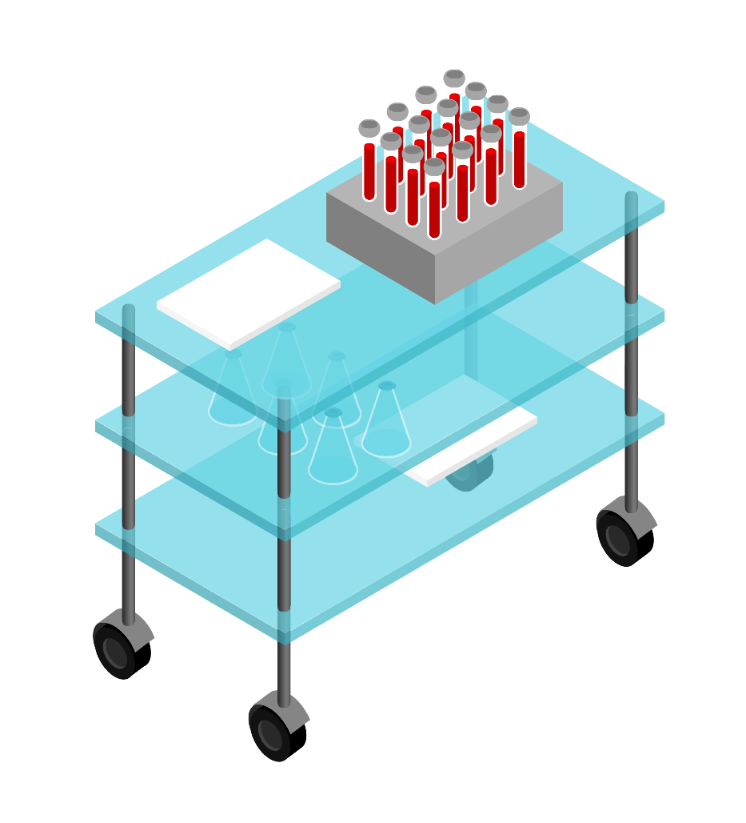
CID
Serial No. | Date | OPD No. | Med_Id | Consumed
1 | 01-JAN-01 | 1 | 1 | 10
2 | 01-JAN-01 | 1 | 2 | 5
3 | 01-JAN-01 | 1 | 3 | 10
4 | 01-JAN-01 | 1 | 4 | 4
5 | 01-JAN-01 | 2 | 1 | 1
6 | 01-JAN-01 | 2 | 2 | 3
7 | 01-JAN-01 | 2 | 4 | 1
8 | 01-JAN-01 | 3 | 1 | 2
9 | 01-JAN-01 | 3 | 3 | 4
10 | 01-JAN-01 | 4 | 3 | 1
11 | 01-FEB-01 | 5 | 1 | 5
Consumption Register
Expired drugs' removal updated in consumption register with OPD Number 0.
Consumption stock log can be obtained by queries on Consumption Register, so removed and consumption register renamed Consumed stock log.
Analysis

Slide 15

Med_ID
Name
Batch_No
Med_ID
ER Diagram
1
is kept in
M
Drug
Batch
M
Expiry_Date
Manuf_Date
is maintained in
Balance
Remark
Med_ID
SID
N
Stock log
OPD No
Received
Date
Consumed
RID
Date
CID
is a
Consumed stock log
Received stock log

Slide 16
Relational Schema
Drug(Med_ID, Name)
Batch(Batch_No, Med_ID, Epiry_Date, Manuf_Date)
Stock_log(SID, Med_ID, Balance, Remark)
Received_stock_log(RID, Received, Date, SID)
Consumed_stock_log(CID, Consumed, Date, OPD_No, SID)
is_maintained_in(Med_ID,SID)

Slide 17
100%
References
Based on a voice call interview of the Pharmacist of Netaji Subhash Chandra Bose, District Hospital, Gorakhpur, U.P.

Slide 18
THANKS

